Slide 1

ISE 585
Case 3: Too early to provide accurate details
OVERVIEW
CHALLENGE
QUESTIONS
A GPS installation estimate challenge
Team 1: Patrick, Rachana, Shruti, William, Mihir
EVALUATION

Slide 2
OVERVIEW
1st
2nd
3rd
4th
Summary
Limitations
Inaccuracies
Alternatives
Summary of the case.
Limitations of the estimate.
Safeguarding inaccuracies.
Provide alternatives.
SUMMARY
LIMITATIONS
INACCURACIES
ALTERNATIVES

Slide 3
Concept & Summary

Slide 4

CONCEPT
Initial design
Product Specification
(Form - fit - function)
Cost Estimation
3 methods:
Top down
Parametric
Buttom up
Contingency
Schedule estimate
Right to left
Left to right
Seven resource categories
Hardware, Software, Documentation, People, Tooling, Equipment, and Facilities.

Slide 5
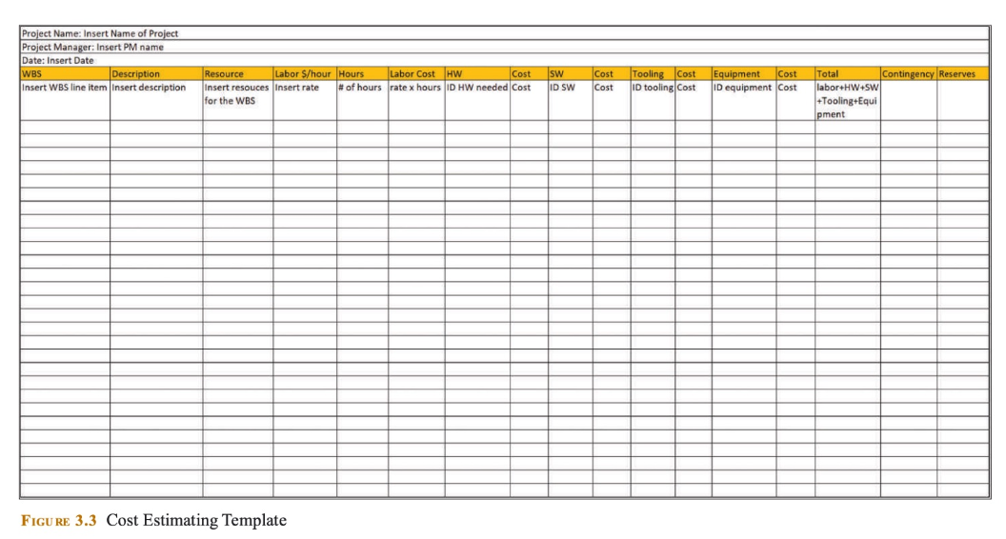
COST ESTIMATING TEMPLATE

Slide 6


CASE
The case describes the challenges faced by a new program manager tasked with estimating the cost of installing a Global Positioning System (GPS). Lacking templates, tools, and system knowledge, coupled with numerous uncertainties, the manager embarked on an extensive inquiry process, consulting with end-users, customer management and technical teams, and internal stakeholders. This process aimed at understanding customer needs and the project's scope, including hardware, software, labor, and other requirements, leading to the creation of a resource matrix. Despite these efforts, the team struggled with accurately estimating the costs of resources, particularly for first-time builds, resulting in an initial estimate they were hesitant to present to the customer due to its potential inaccuracies.

Slide 7
CHALLENGE SUMMARY
STRENGTHS
WEAKNESSES
Stakeholder communication.
Methods like 5W and 1H to gain knowledge of the system
No prior knowledge of the system or similar systems.
No experience in building these systems.
OPPORTUNITIES
THREATS
Project failure.
Estimate off by +-30%.
Tasks not go as per schedule
Better future relationship with the client.
More opportunities to work with the client.
Notes:
MIHIR
Description of the case
SWOT Analysis - (generic aspects of strength, weakness like a new team, opportunities and strengths concerning the project)
More information on the case? Who are the clients and is it a B2B product or B2C?

Slide 8
If you had to present this as an estimate to a client, what limitations would you make clear to the customer?

Slide 9
LIMITATIONS
01
04
Lack of similar project knowledge
Usage of first time build resources
02
05
Scope creep & changes in requirements
Iterative cost estimation
03
06
Technical glitches affecting system fidelity
Unforeseen risks
Notes:
When presenting such an estimate to a client, it's crucial to communicate the limitations clearly to manage expectations effectively. These limitations include:
Lack of Previous Experience: Acknowledge that the team does not have prior experience with similar projects, which may affect the precision of the estimate.
Technical Glitches: Possible issues include signal interference, hardware issue, software error, multipath effect, environmental conditions, and user error.
First time build resources: Lack of tools and template and benchmark projects make it difficult to come up with an accurate estimate.
Potential for Scope Creep: Warn about the possibility of unforeseen requirements or complexities emerging as the project progresses, impacting costs.
Cost estimation: Only a range of values can be given as a cost estimate and a single point value cannot be given due to uncertainties and assumptions.
Risks: Apart from these potential uncertainties, there can be a variety of unforeseen risks eg: supply chain and regulatory issues

Slide 10
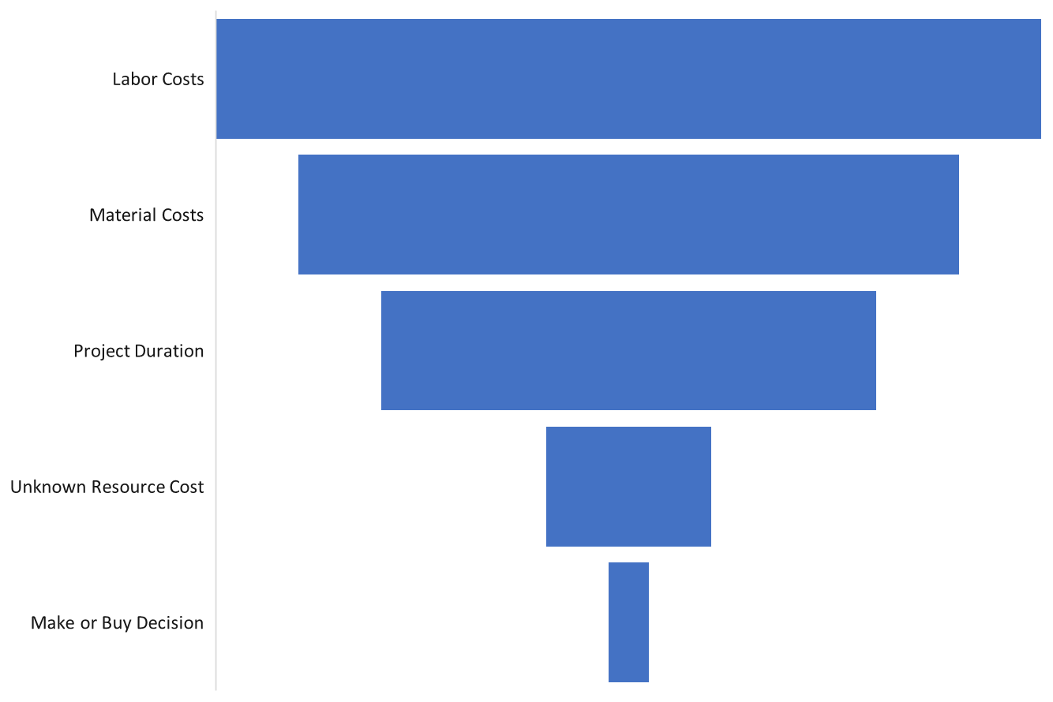
Sensitivity Analysis
Tornado Approach
Impact on Cost Estimate
DETAILS
1
Identify parameters that impacts cost
METHOD
2
Define range of values
for parameters
CRITERIA
3
Evaluate impact on
output
Notes:
We have done sensitivity analysis using tornado approach to come up with the risk matrix and evaluate its impact on the cost estimate.

Slide 11
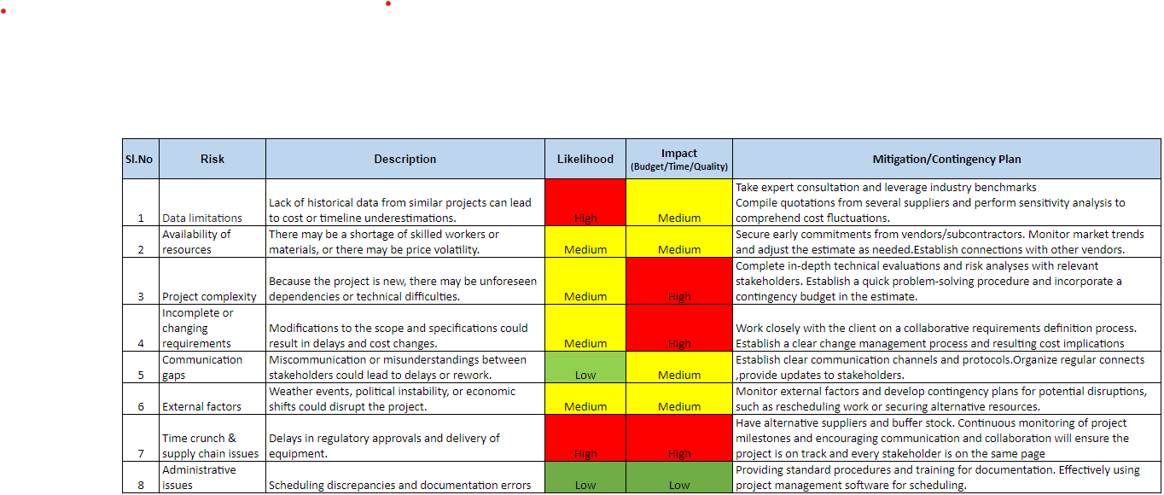
GPS Estimation Risk Matrix
Please refer the link for the detailed risk matrix GPS Risk Register
Notes:
Link to Risk Matrix of GPS Estimation : ISE 585 Risk.xlsx - Google Sheets

Slide 12
How would you protect the inaccuracy of this estimate?

Slide 13
What are the sources of the inaccuracies?
KNOWLEDGE GAPS
In some cases, the components, assembly, and integrations required are a first build for the organization.
MATERIAL COST
The cost of raw materials, tooling, and equipment is always fluctuating.
DESIGN CHANGES
Design changes are almost inevitable with a first time build which could affect cost and schedule.
Notes:
WL
Defend the inaccuracy:
Contingency and reserves
Iterative revisions
Feedback mechanisms and Collaboration
Being transparent to the customer regarding the knowledge gap
Documentation
Consultation with expert professionals
References with people who can showcase our credibility
Benchmarking

Slide 14
How do we protect the inaccuracies of the estimate?
 | KNOWLEDGE GAP | MATERIAL COSTS | DESIGN CHANGES
STRATEGY 1 | Consult with SME’s both in and out of the organization if necessary. | Include a reserve fund to account for fluctuations in raw materials, equipment, etc. | Propose a plan for revisiting and adjusting the estimate at key project milestones as more information becomes available.
STRATEGY 2 | Assumptions will drive the estimate, thus, document all assumptions made to make decisions easier downstream. | Gather quotes, begin to build supplier relations, develop a wide supply base. | Design an MVP / prototype if possible and use parametric modeling to scale cost or factor changes in.
Notes:
WL
Contingencies, overestimates or underestimates.
2. Protecting Against the Inaccuracy of the Estimate
To safeguard against the potential inaccuracy of the estimate:
Contingency Planning: Include a contingency fund to cover unforeseen costs, ensuring the estimate is flexible enough to accommodate changes.
Iterative Revisions: Propose a plan for revisiting and adjusting the estimate at key project milestones as more information becomes available.
Transparent Communication: Maintain open lines of communication with the client, providing updates on potential shifts in the estimate due to emerging insights.
Documentation of Assumptions: Clearly document all assumptions made during the estimating process, allowing for easier adjustments and justifications later.
Benchmarking.
WL + RN: References - people who we have referred to showcasing our credibility

Slide 15
What alternatives would you offer?

Slide 16
ALTERNATIVES
Call in specialized external experts to support the estimation and team assumptions
Break the project into small phases, starting with a prototype batch and use this estimation to scale up for the full project
Expert Consultation
Phased
Approach
Offering
Pricing
Flexibility
Joint Risk Management
Propose pricing models accommodating for changes, such as time and materials contracts
Engage client with partnership approach, where both parties share responsibility for managing risk
Notes:
PO
3. Offering Alternatives
Given the uncertainties involved in the estimate, offering alternatives can help manage risks and client expectations:
Phased Approach: Suggest breaking the project into smaller, manageable phases, each with its own more accurate estimate as the project scope becomes clearer.
Flexible Pricing Models: Propose pricing models that accommodate changes, such as time and materials contracts, which can adjust for actual costs incurred.
Expert Consultation: Recommend bringing in external experts with experience in similar projects for a more informed estimate or for validating the team's assumptions.
Joint Risk Management: Engage the client in a partnership approach to risk management, where both parties share the responsibility for managing and mitigating project risks.
MVP, prototype or POC before full scale development.

Slide 17
REFERENCES
PES University. (n.d.). Our brand identity. Retrieved February 8, 2024, from https://pes.edu/brand-identity/
Tornado Analysis. (n.d.). Ineight. Retrieved February 8, 2024, from https://learn.ineight.com/Schedule/Content/7%20Review%20Process/5%20Tornado%20Analysis.htm?TocPath=Topics%7CReview%20Process-%20Risk%20Overview%7C_____5
https://hellotracks.com/en/blog/How-to-Improve-your-GPS-Accuracy/
Text: "Product Development for Technical and Non-Technical Managers and Practitioners, 1st Ed., Lu, P. Kendall Hunt (2021).

Slide 18
APPENDIX
Detailed SWOT analysis
Strengths:
Proactive Inquiry: The program manager's initiative to ask questions and engage with a wide range of stakeholders (end-users, customer management and technical teams, and internal stakeholders) demonstrates a strong approach to gathering comprehensive information.
Team Collaboration: The collaborative effort in building a resource matrix shows the team's ability to work together and leverage internal resources to tackle the project's challenges.
Weaknesses:
Lack of Experience: The team's lack of experience and knowledge about GPS installation projects and similar projects presents a significant weakness, impacting their ability to make informed estimates.
Inadequate Tools: The absence of templates and tools for estimating costs adds to the difficulty of creating an accurate project estimate.
Opportunities:
Learning and Development: This project presents an opportunity for the team to gain valuable experience in GPS installations, which could be beneficial for future projects.
Process Improvement: The challenges faced could encourage the development of new tools, templates, and processes for estimating costs, improving efficiency for future projects.
Threats:
Estimation Inaccuracy: The potential for significant inaccuracy in the estimate due to unknown factors poses a risk to project success, budget, and client satisfaction.
Client Confidence: Presenting an estimate with acknowledged inaccuracies could undermine the client's confidence in the team's ability to deliver the project successfully.
Detailed RISK Matrix
GPS Risk Register

Slide 19
Thank You

